Slide 1
Home health care
Data Semantics
ILS Z636/ INFO I590
Anirudh Pillai, Saloni Sharma, Neha Bisht

Slide 2
INTRODUCTION
Home health care is a wide range of health care services that can be given in your home for an illness or injury.
It is usually less expensive, more convenient, and equivalent to as much care you get as in a hospital or skilled nursing facility..

Slide 3
DATASET DESCRIPTION
RDF Dataset from DATA.GOV
23 Key Performance Indicators for Home Health care services measured across all the states in US
Indicators include How often services began timely check up, How often the team included treatments for the pressure or bedsores and indicators related to post treatment recovery

Slide 4
WHY DISCUSS BEDSORES?
Very common in the US.
Can reduce overall quality of life because of pain and treatments and takes long time heal.
Expensive to treat.

Slide 5
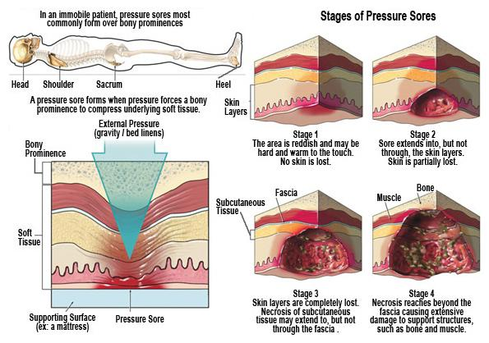
WHAT ARE BEDSORES?
Also called pressure sores, pressure ulcers or decubitus ulcers, they are skin wounds that result from prolonged pressure on the skin that's in contact with a bed or wheelchair. Esp- hips, back, elbows, ankles and heels, where bone and skin are very close in contact.

Slide 6
Purpose of Analysis
By analyzing the data using sparql queries and tableau, we could comment on how they can improve their services, where it might most be needed.

Slide 7
Depression and Bedsores
People with depression sometimes stay in bed more since they are highly demotivated. In such cases, they might develop pressure sores and they might not even realize it.
Therefore it is very important that the family/caregiver have an idea about these sores and that the home health services check for pain.

Slide 8
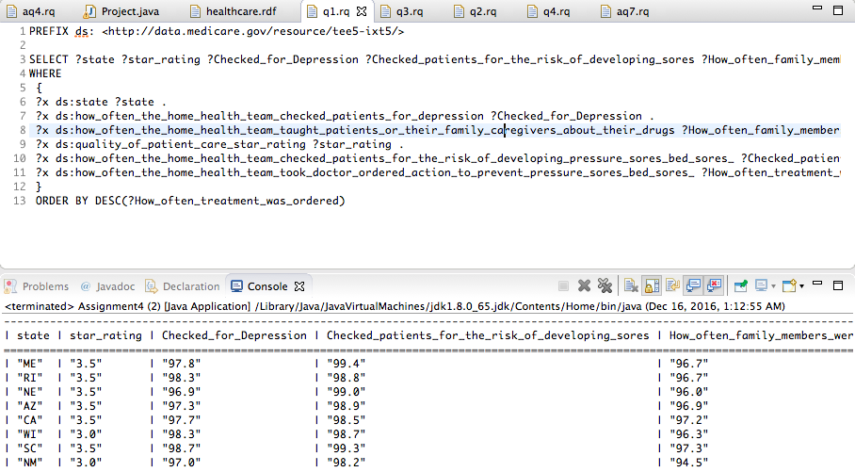
Depression and Bedsores
Query, result, visualization
We can see that the states where the % of times the patients were ordered a treatment were high, were also the states with high frequency for depression and bed sore checks.

Slide 9
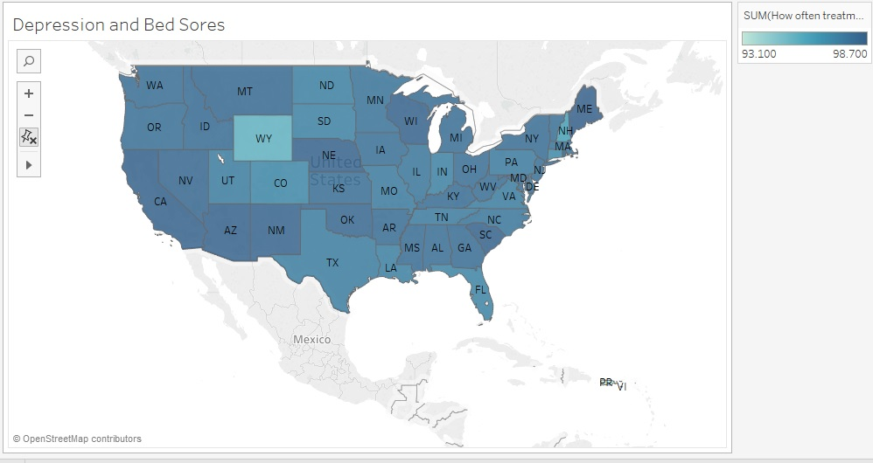

Slide 10
Diabetes and Bedsores
Delayed wound healing is observed in lot of diabetic patients due to a number of reasons like blood glucose levels, poor circulation, diabetic neuropathy, etc.
In diabetic neuropathy they experience loss of sensation.
So, it is very important for patients to keep pressure off of a wound to aid healing.

Slide 11
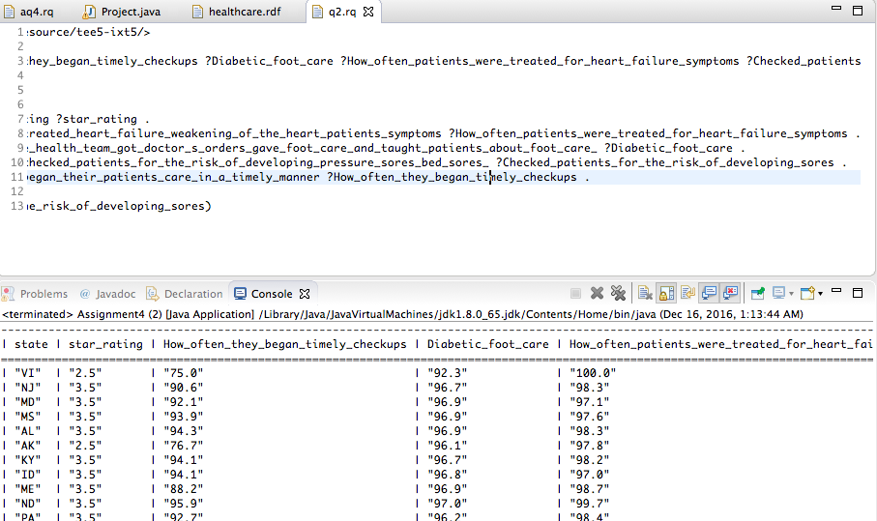

Slide 12
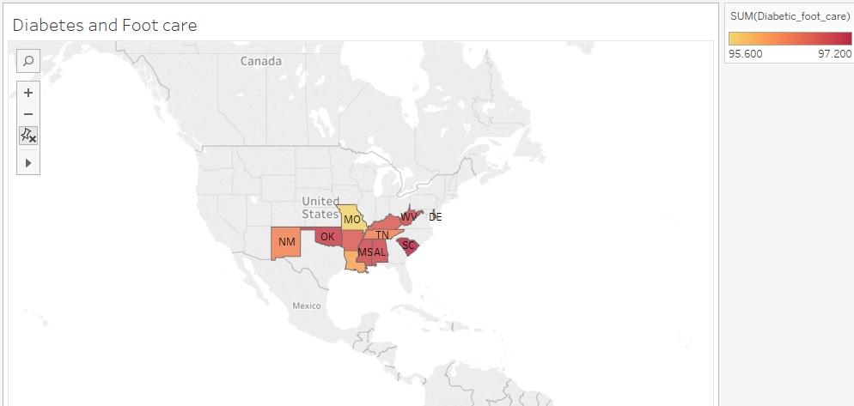

Slide 13
Measures Taken by the team Pre-Treatment
These include measures like :
How often they took doctor ordered actions to prevent bedsores.
How often did the plan include the treatment.
How often the team checked for developing bed sores.

Slide 14
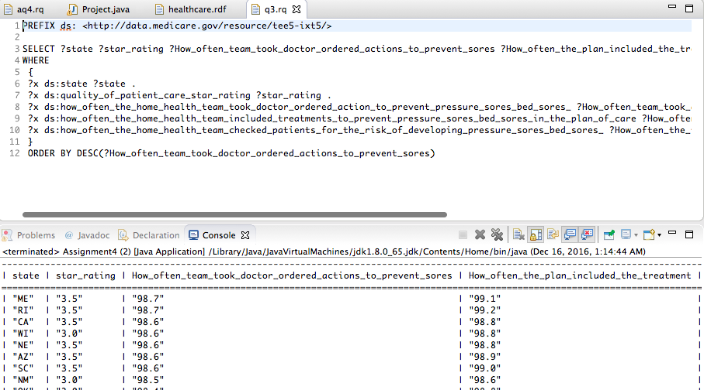

Slide 15
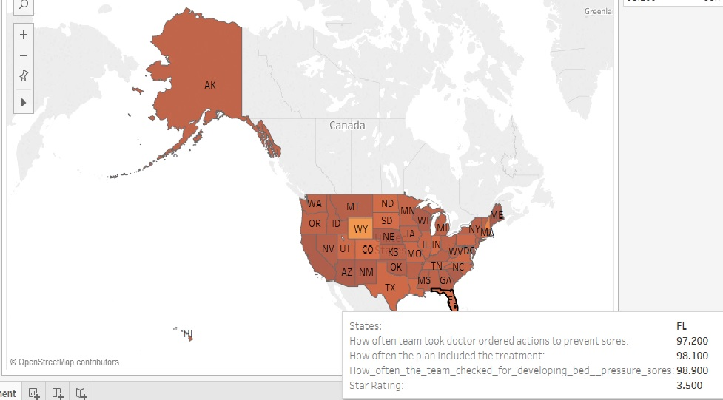

Slide 16
Post Treatment Care
Post treatment care in a situation such as bedsore wound healing is as important as the treatment itself.
As mentioned earlier, it costs a lot to the patients.
Sometimes patients are/have to be bed-ridden for as long as 6 months or more.

Slide 17
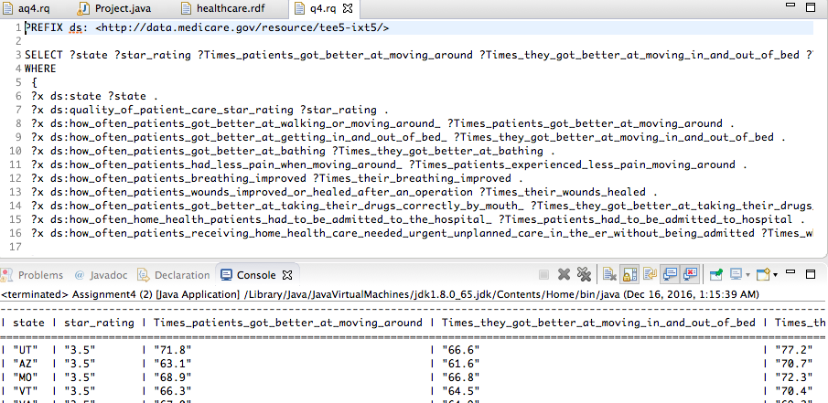

Slide 18
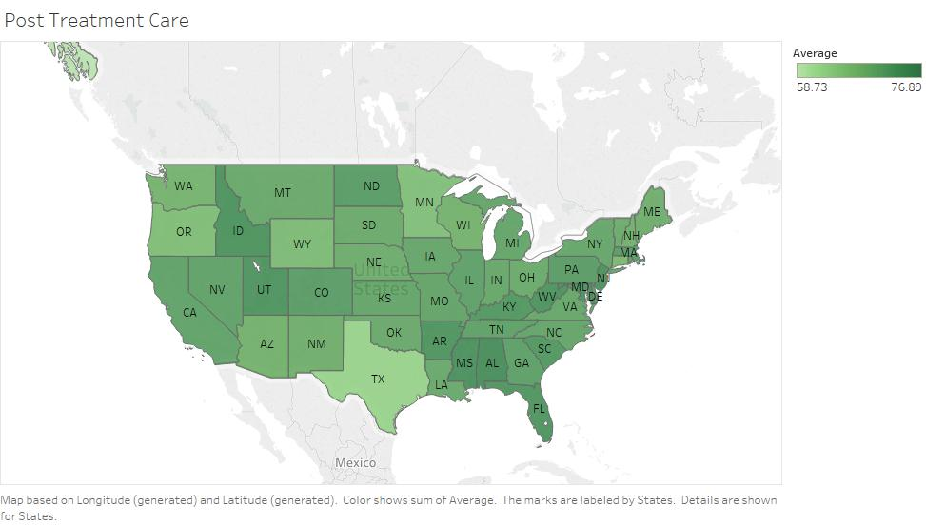

Slide 19
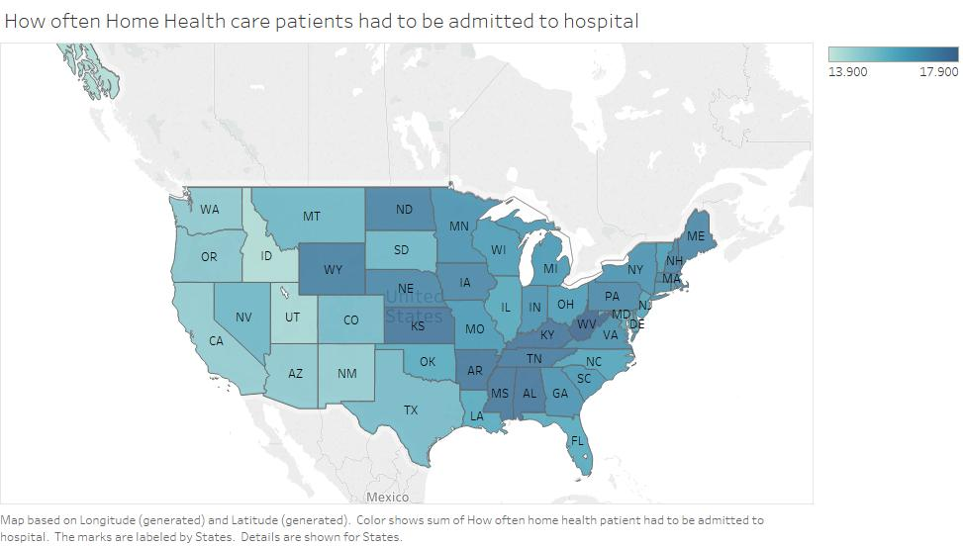
Unexpected happenings

Slide 20
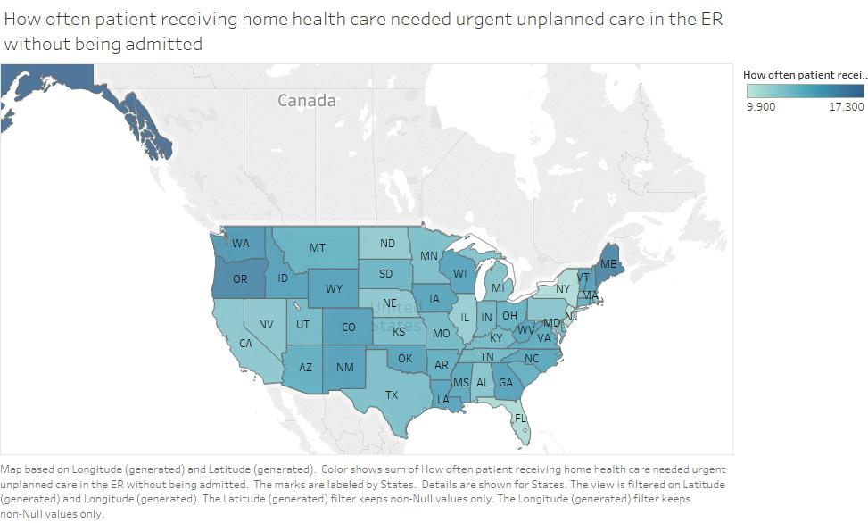

Slide 21
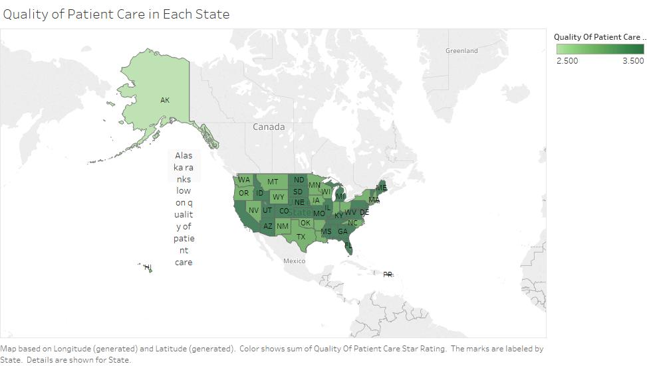

Slide 22
Conclusion
As you see, on an average the home health care services seem to be working okay since a lot of states have a good overall rating.
But there is always room for more improvement.
For example- in states like Alaska, Texas and Oregan they can definitely work on their post treatment care services.
Also, Alaska and Texas are rated the worst in health care.

